Slide 1
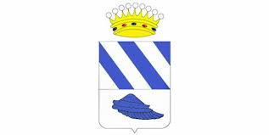
TRADITIONS OF ALCORA

Slide 2
In this activity I’m going to explain you the most important festivities in Alcora.
The patron saints of Alcora are «Sant Cristàfol» and «El Crist del Calvari».
These fesivities are celebrated in honour of them.

Slide 3
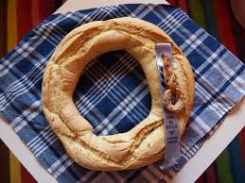
«DIA DEL ROTLLO»

Slide 4
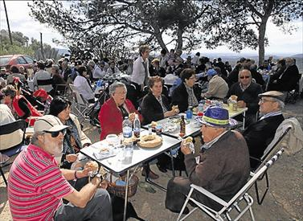
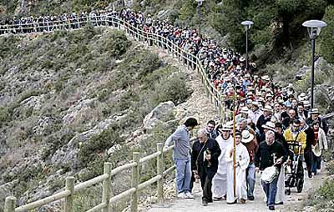
This festivity is celebrated the Monday after the Easter Sunday.
The festivity starts at 8.00 o’clock.
The tradition is to climb in pilgrimage the mountain where the patron saint’s hermitage is.
When the pilgrimage arrives, there is a mass and then all the people have a brunch around the hermitage.

Slide 5
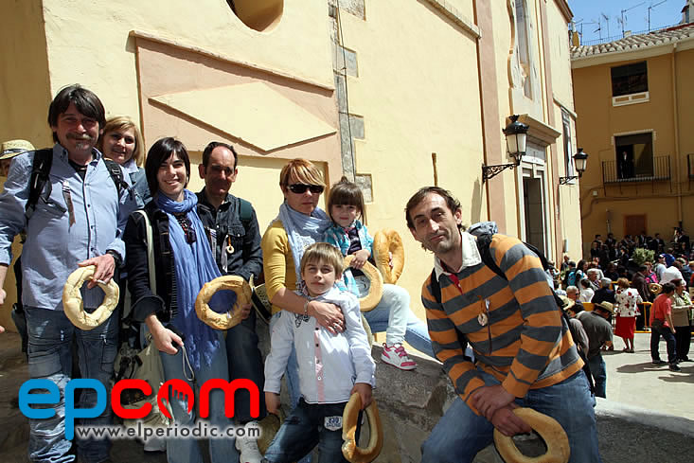
At 12.00 o’clock, people return in pilgrimage to the church of the city.
When they arrive, the mayor and his/her team give them a roll, which is typical of Alcora.

Slide 6
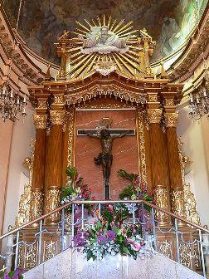
«DIA DEL CRISTO»

Slide 7
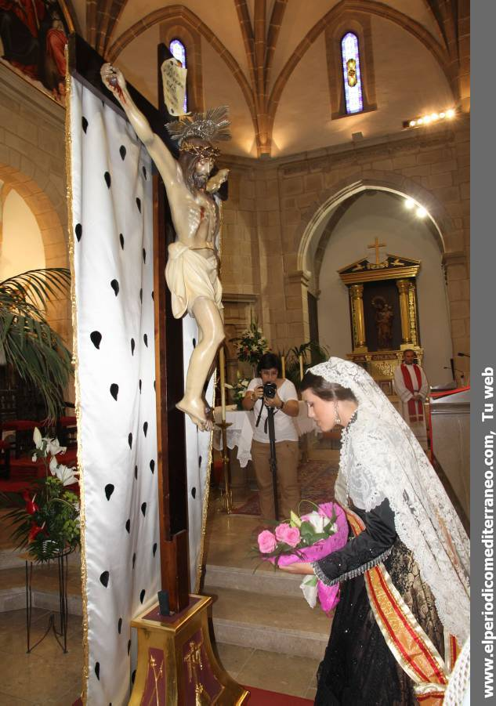
This festivity is celebrated the last
Sunday of August.
It starts at about
20.00, when the Queen of the festivities offers flowers to the patron saint, who is in the church of the city.

Slide 8
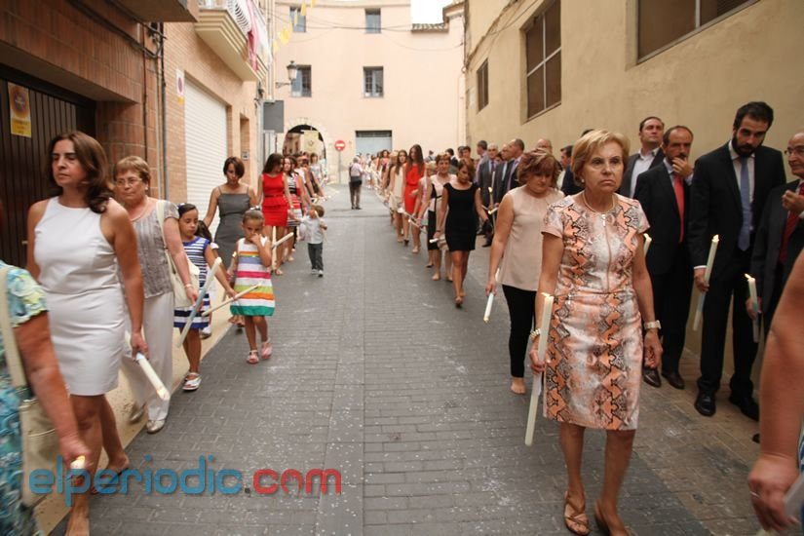
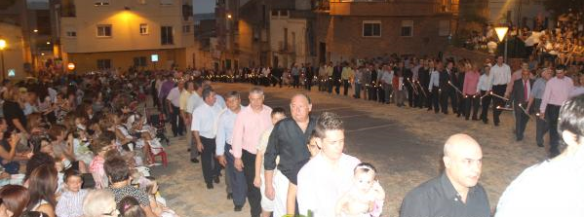
Then people go in pilgrimage to the Calvary of the city.
They walk in silence and with a candle in their hands.

Slide 9
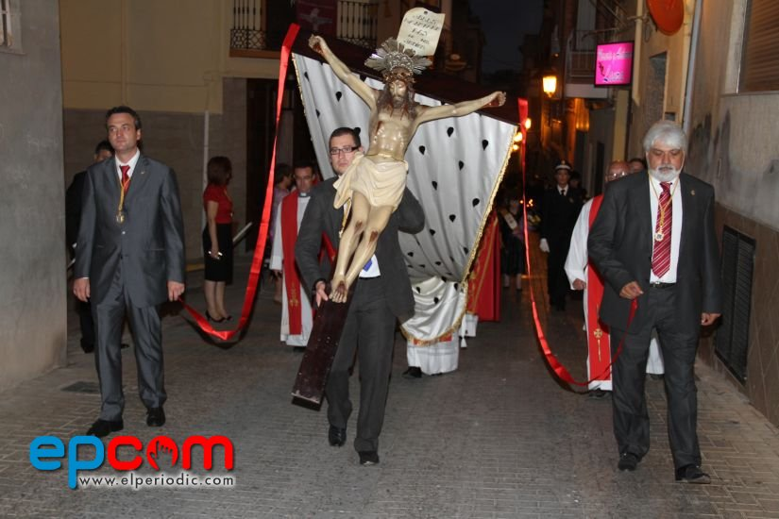
The meaning of this festivity is to take the patron saint to the Calvary, where he is all the year.
The mayor and his/her team carry the patron saint from the church to the Calvary.

Slide 10
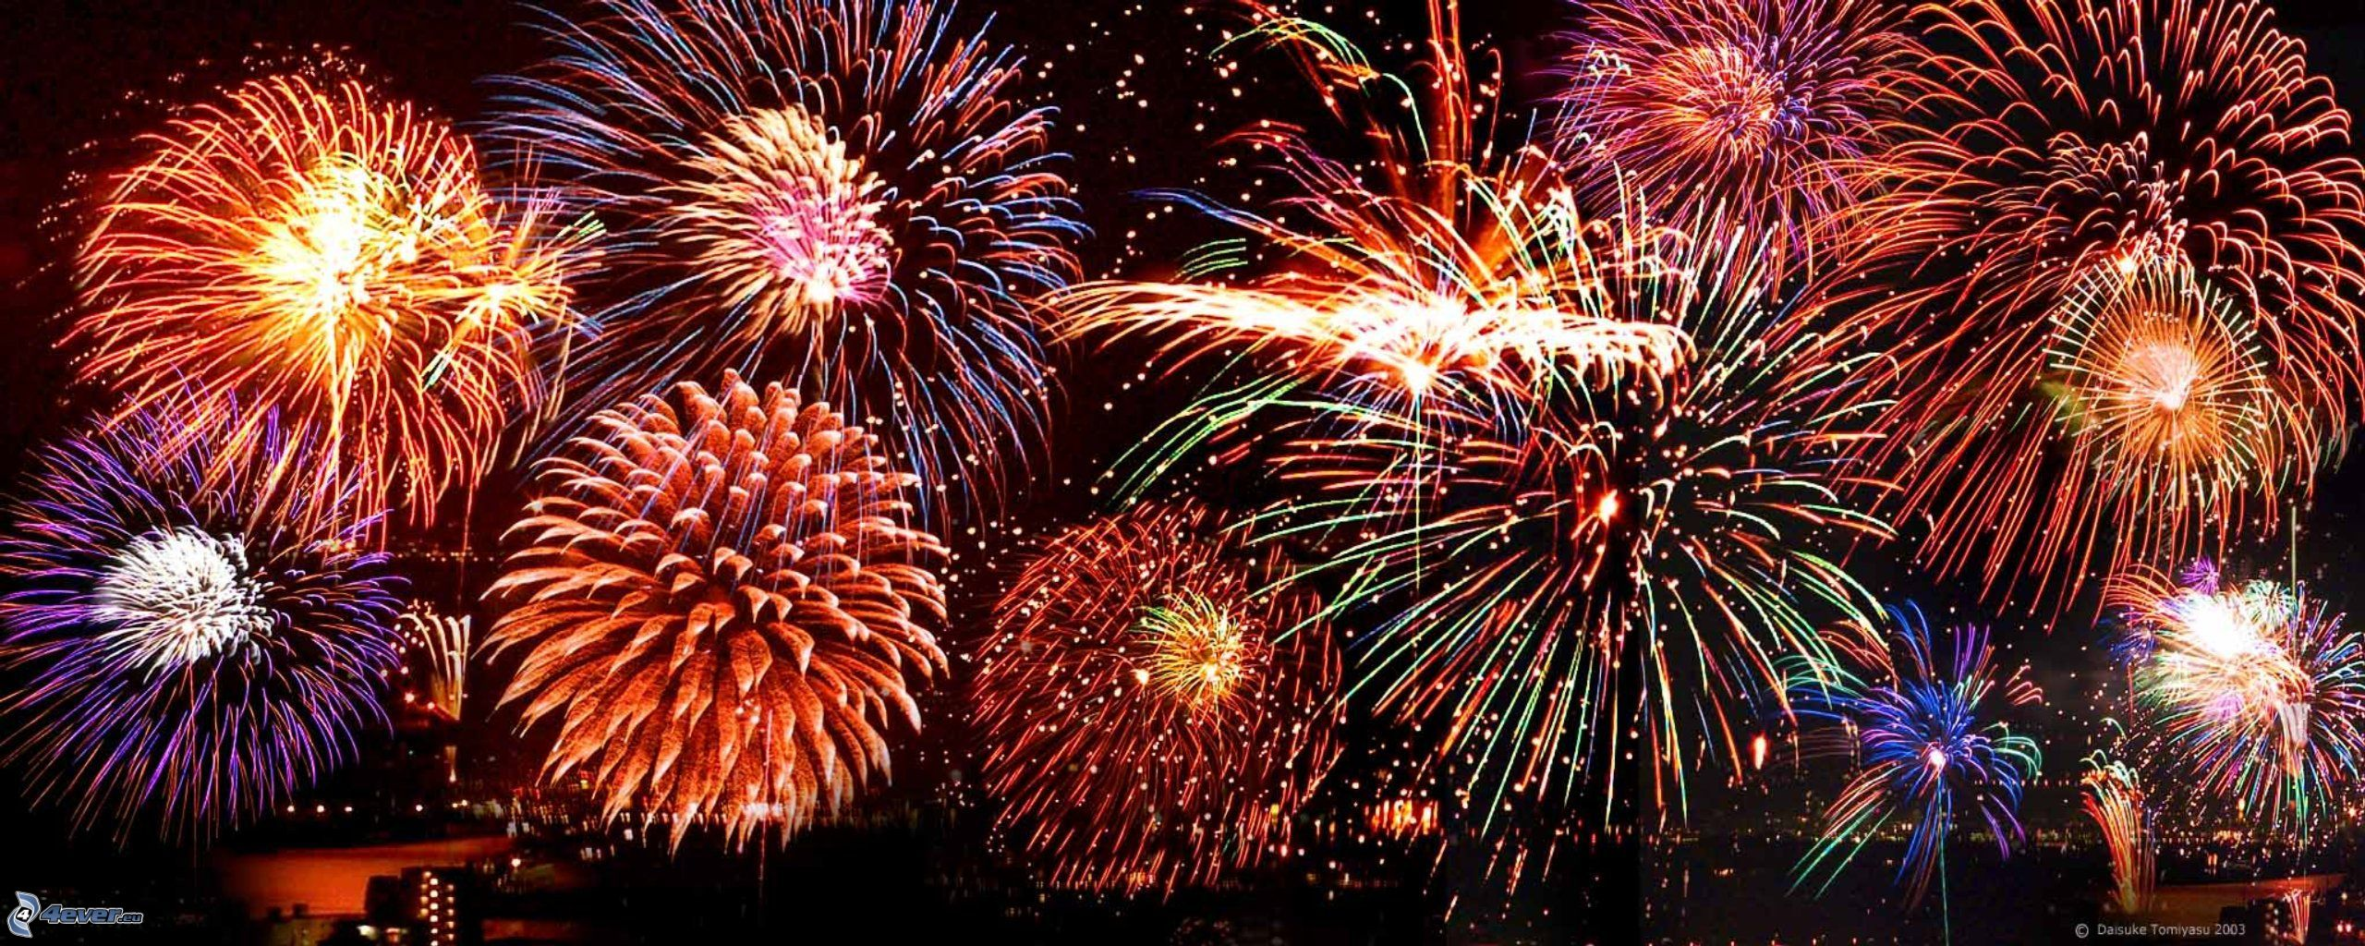
When all the people have arrived, fireworks are launched.

